Slide 1
Data Visualization for analyzing Healthcare and Educational spending for the top 10 G-20 countries
Varsha Waingankar
MS Data Science, George Washington University

Slide 2
Overview
Data Source – World Bank Open data.
Used the G-20 countries.
Selected top ten countries in respective fields like Healthcare, Educational spending.
Considered six years of data ranging from (2010 to 2015).
Google APIs, JavaScript and HTML
Various charts used – Column charts, Geo Maps, stacked bar, Bar charts, Scatter charts, Trend lines, Bubble charts, Pie charts.
Conclusion

Slide 3
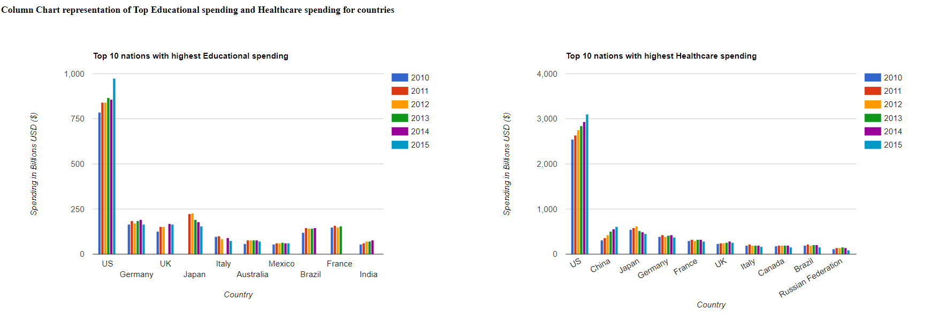
Question 1: The Educational and healthcare spending of at least the top 10 nations

Slide 4
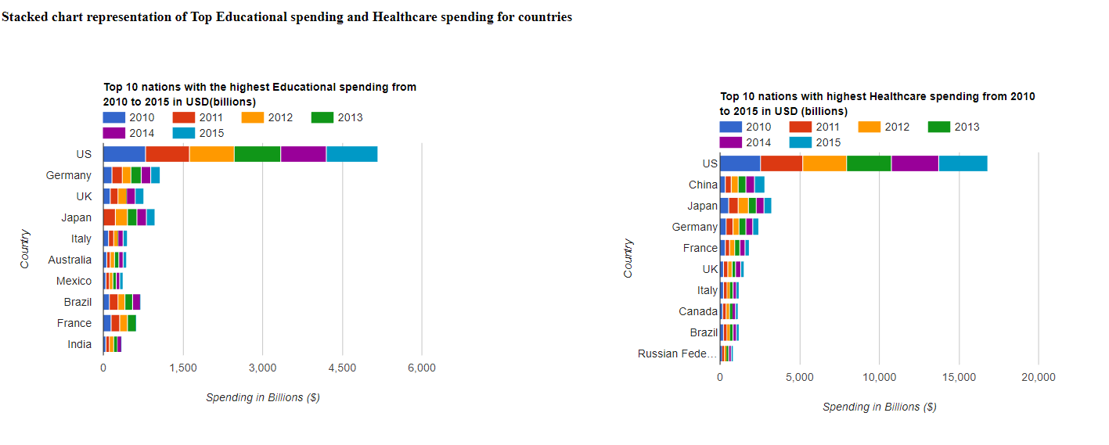
Question 1: The educational and healthcare spending of at least the top 10 nations

Slide 5
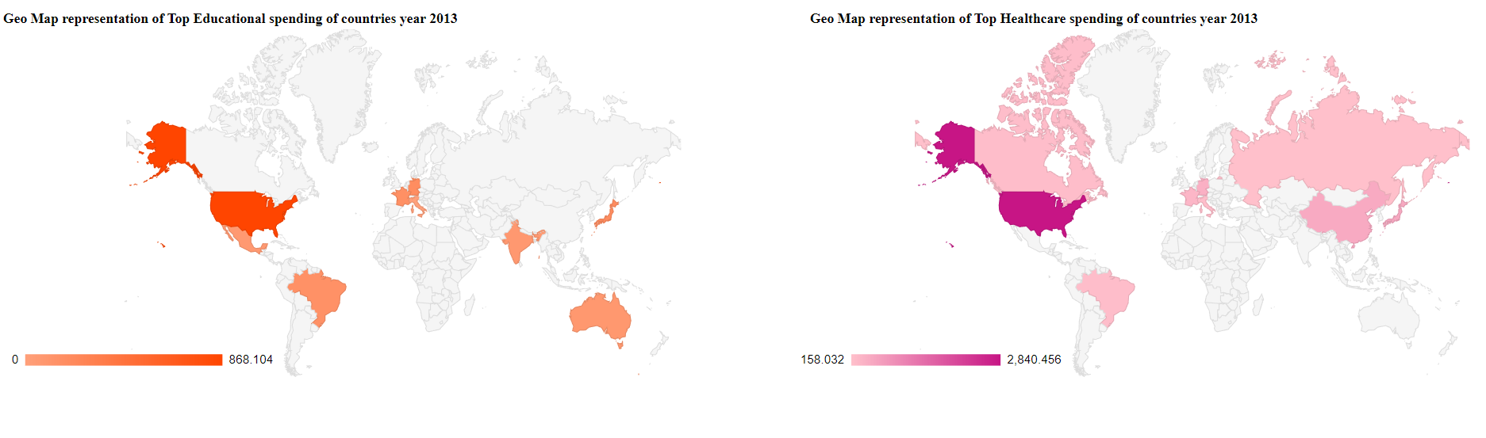
Question 1: The educational and healthcare spending of at least the top 10 nations

Slide 6
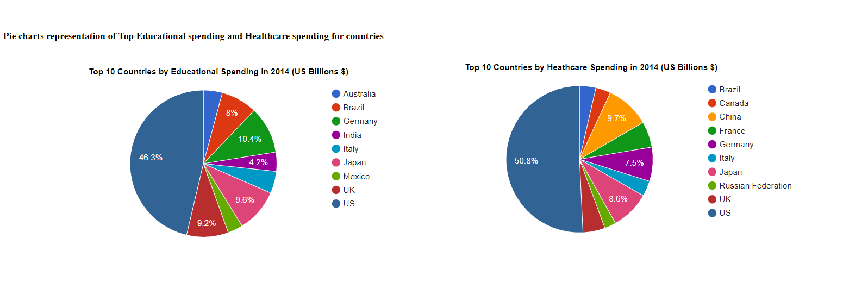
Question 1: The educational and healthcare spending of at least the top 10 nations

Slide 7
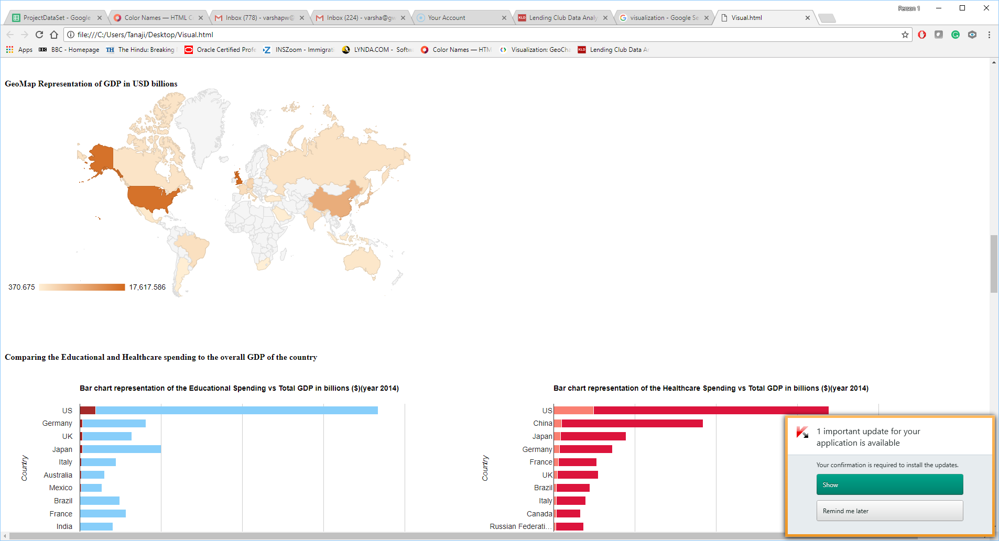
Question 2: Compare the data to the country’s GDP

Slide 8
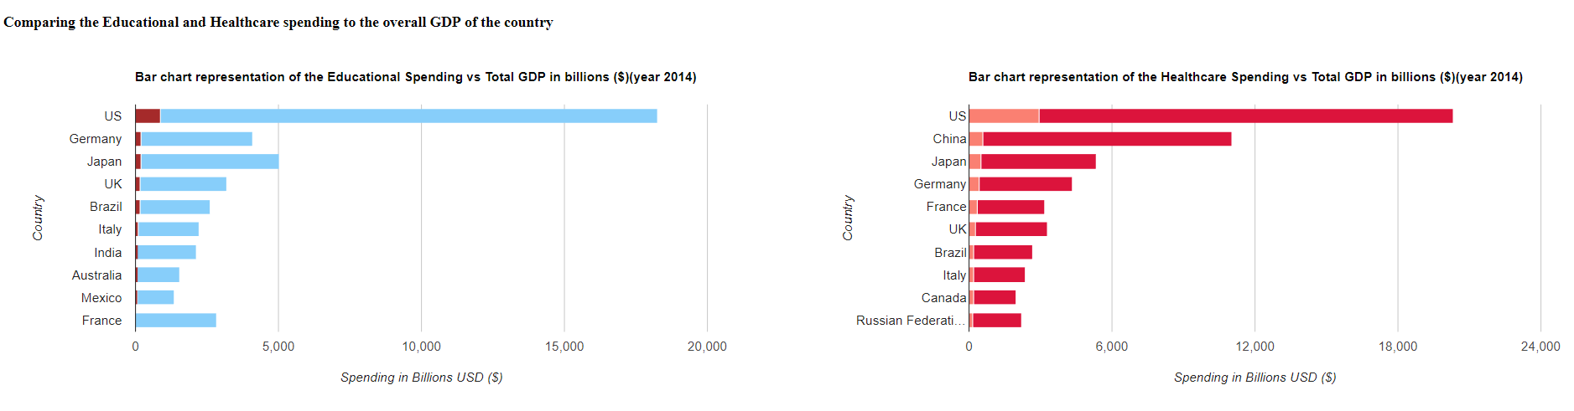
Question 2: Compare the data to the country’s GDP

Slide 9
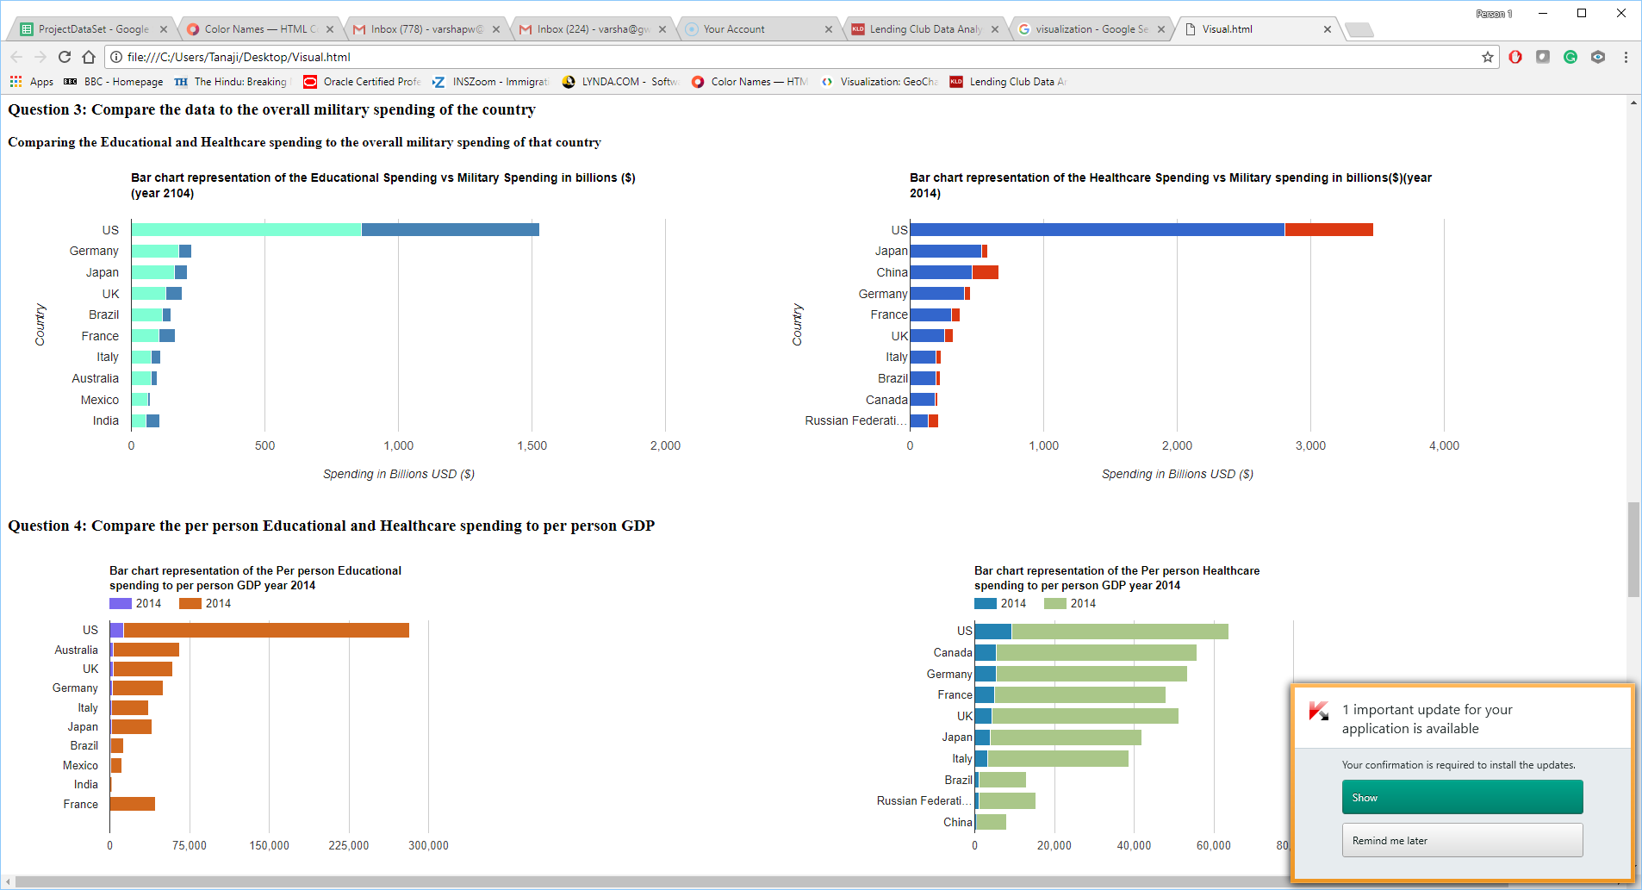
Question 3: Compare the data to the overall military spending of the country

Slide 10
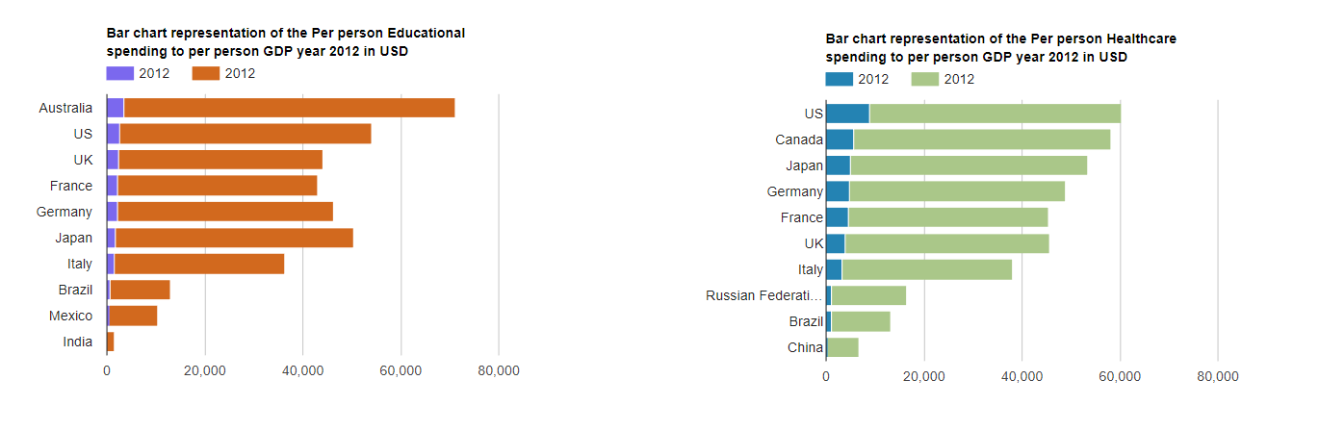
Question 4: Compare the per person Educational and Healthcare spending

Slide 11
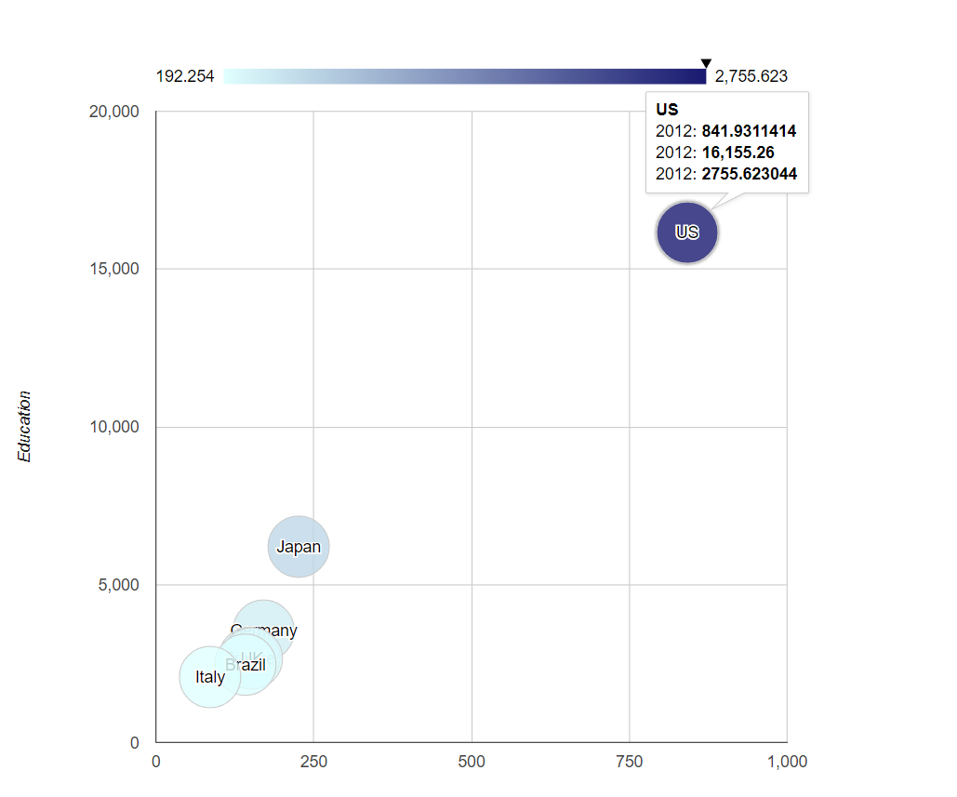
Bubble chart representing the relationship between Health, GDP and Education

Slide 12
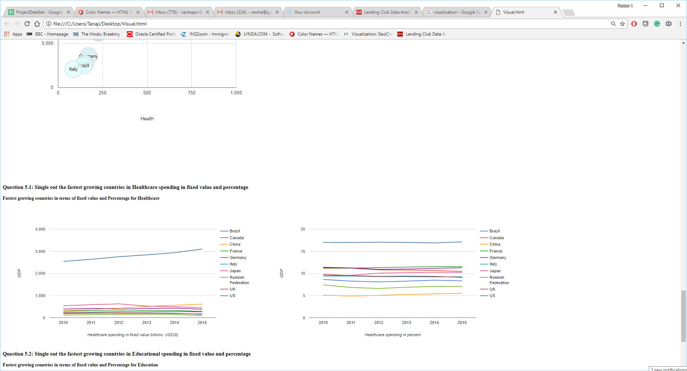
Question 5.1: Single out the fastest growing countries in Healthcare spending

Slide 13
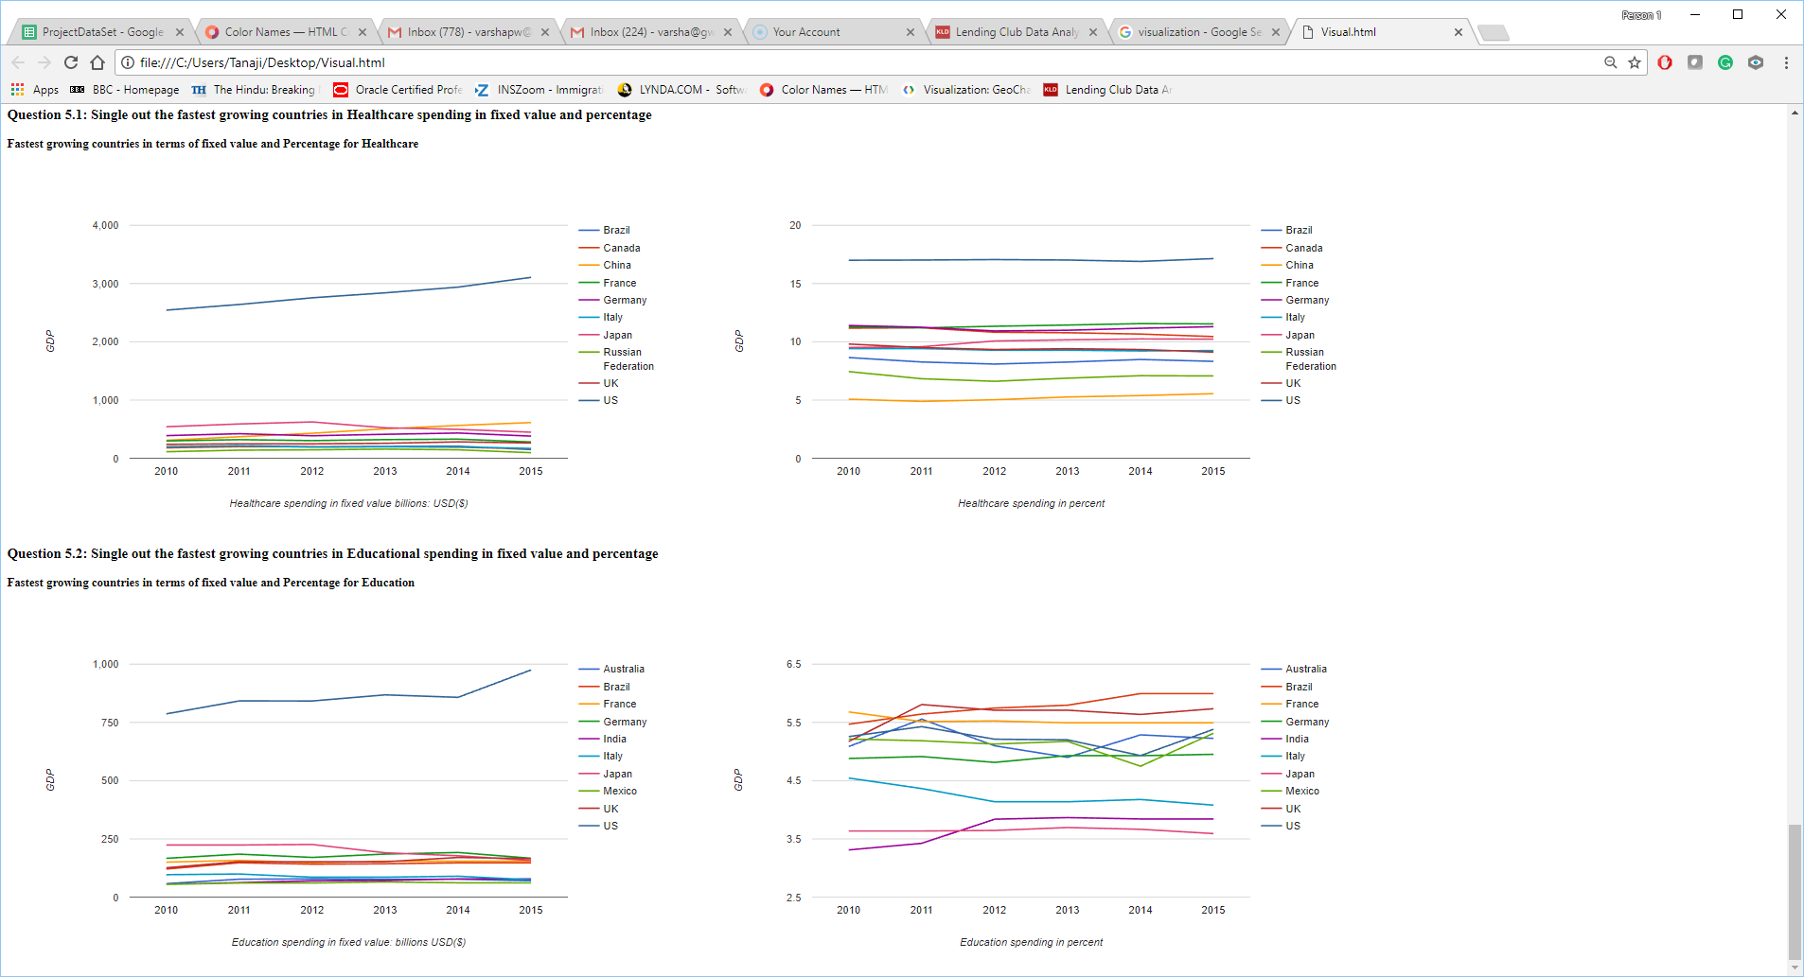
Question 5.2: Single out the fastest growing countries in Educational spending

Slide 14
Conclusion
The USA ranks the highest in GDP (16,473 billions usd), Educational (975 billions usd) and healthcare (3106 billions usd) spending in terms of fixed value.
In terms of percent spending on Education Brazil ranks the highest, that is 5.99 percent of the total GDP
In terms of percent spending on Healthcare USA ranks the highest, that is 17.1 percent of the total GDP

